Slide 1
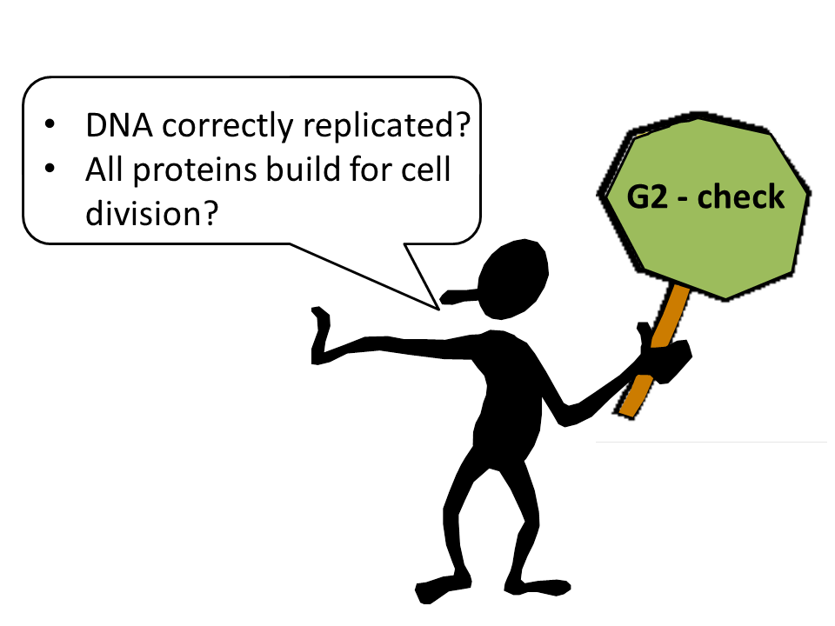
G2: Second Gap Phase
Key features
DNA is replicated
4N DNA content: 92 chromosomes
Checkpoint
Replication complete?
DNA damage present?
→ commit to Mitosis

Slide 2
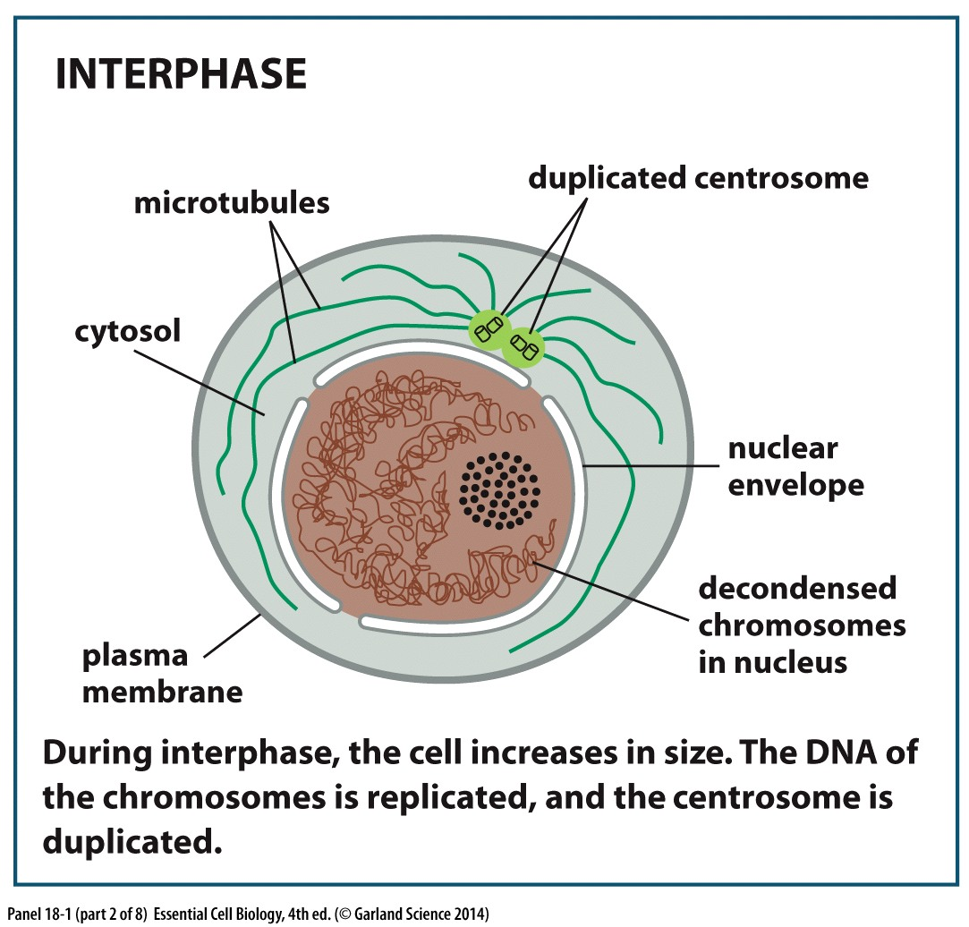
G1 → S → G2: preparing for division

Slide 3
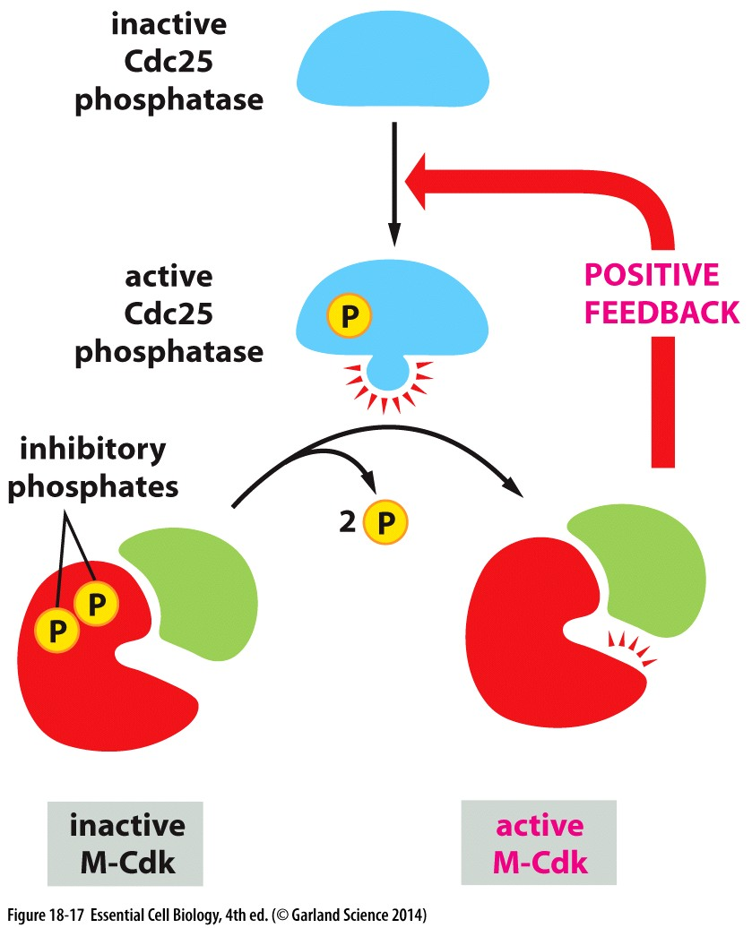
M Phase: Mitotic Division
M phase is initiated and reinforced by a feedback loop
Activated Cyclin/CDK phosphorylates/activates it’s own activating pathway
Activation of proteins necessary for cell division

Slide 4
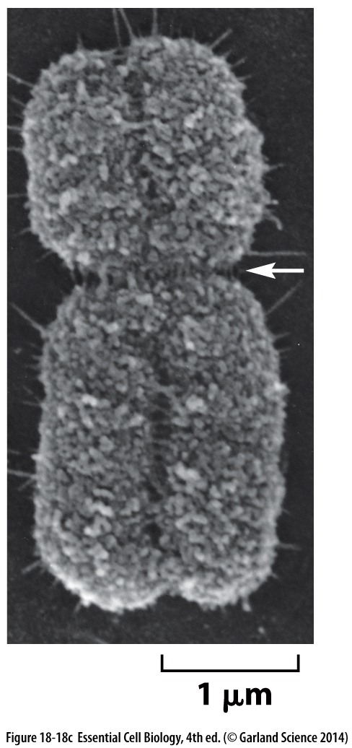
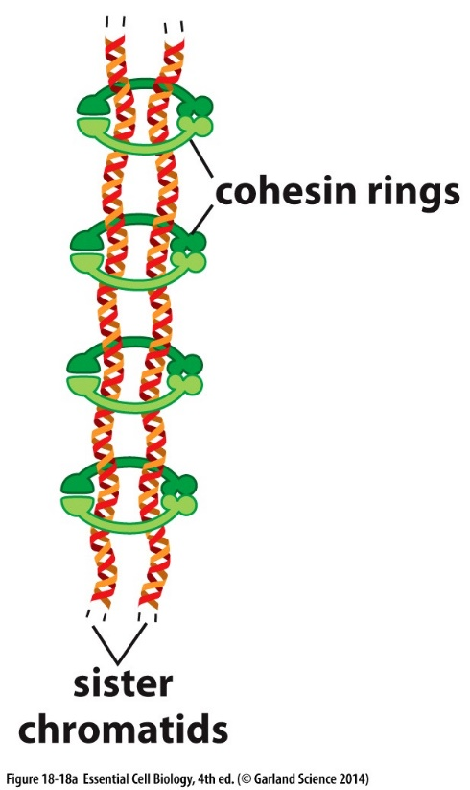
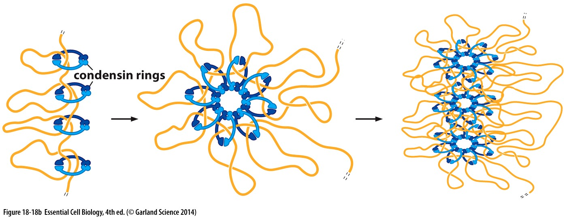
M Phase: Mitotic Division
Key features
DNA is condensed
Mitotic spindle forms
Chromosomes are segregated
Primary constriction: where chromosome attaches to microtubules of the mitotic spindle
Kinase cascade initiates condensation
Cohesion is established in S phase

Slide 5
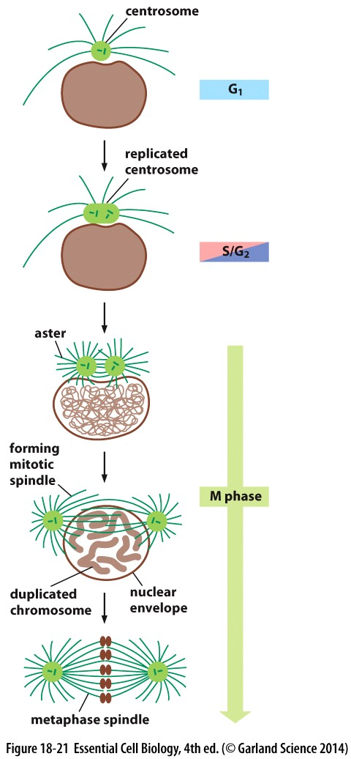
‘Wait Anaphase’ Spindle Assembly Checkpoint
Successful & equal chromosome division requires:
Mitotic spindle with TWO spindle poles forms
ALL chromosomes to attach properly to the spindle
Microtubules must locate and bind defined region on each chromosome (all 96 of them!)
→ checkpoint is satisfied

Slide 6
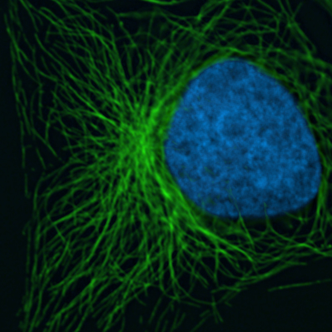
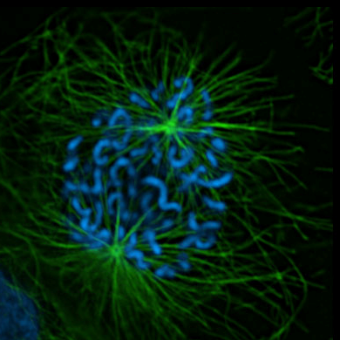
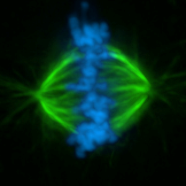
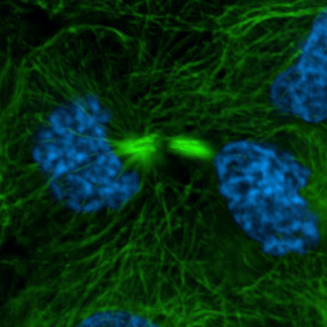
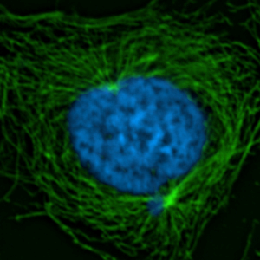
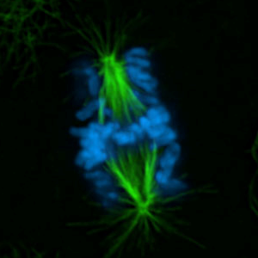
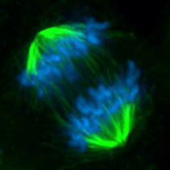
Mitotic Progression
G1/early S phase
Telophase
S/G2 phase
Anaphase
Prophase
The mitotic checkpoint: a safeguard to protect against aneuploidy
Metaphase
Prometaphase
DNA
Microtubules

Slide 7
S/G2 phase
Chromosomes are replicated (Checkpoint)
Centrosomes are duplicated
Chromosomes begin to condense
Prophase
Nuclear Envelope breaks down
Centrosomes nucleate microtubules/spindle poles
Kinetochores form

Slide 8
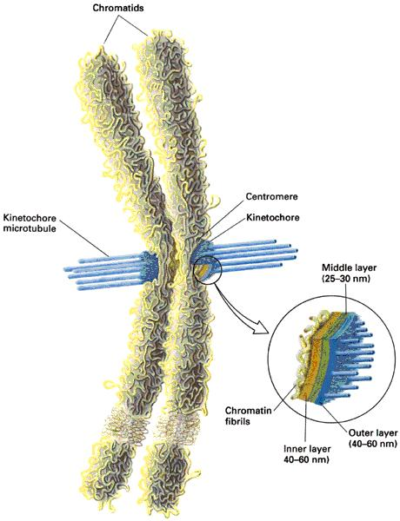
S/G2 phase
Chromosomes are replicated (Checkpoint)
Centrosomes are duplicated
Chromosomes begin to condense
Kinetochore forms at the centromere
Multiple functions:
attaching to microtubules
chromosome movement
Over 50 different proteins, present in numerous copies
Human kinetochore holds 20-25 microtubules
Prophase
Nuclear Envelope breaks down
Centrosomes nucleate microtubules/spindle poles
Kinetochores form

Slide 9
S/G2 phase
Chromosomes are replicated (Checkpoint)
Centrosomes are duplicated
Chromosomes begin to condense
Prophase
Nuclear Envelope breaks down
Centrosomes nucleate microtubules/spindle poles
Kinetochores form
Prometa-
phase
Bipolar Spindle begins to form
Microtubules attach to kinetochores
Chromosomes move and begin to align at cell center

Slide 10
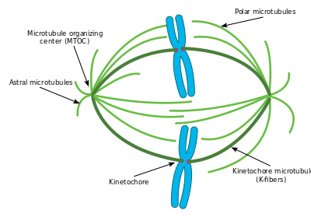
S/G2 phase
Chromosomes are replicated (Checkpoint)
Centrosomes are duplicated
Chromosomes begin to condense
Prophase
Nuclear Envelope breaks down
Centrosomes nucleate microtubules/spindle poles
Kinetochores form
Prometa-
phase
Bipolar Spindle begins to form
Microtubules attach to kinetochores
Chromosomes move and begin to align at cell center
Dynamic microtubules ‘search’ cytoplasm and ‘capture’ kinetochores
Kinetochore attachment stabilizes microtubules to form kinetochore fibers (k-fibers)
K-fibers direct chromosome movement

Slide 11
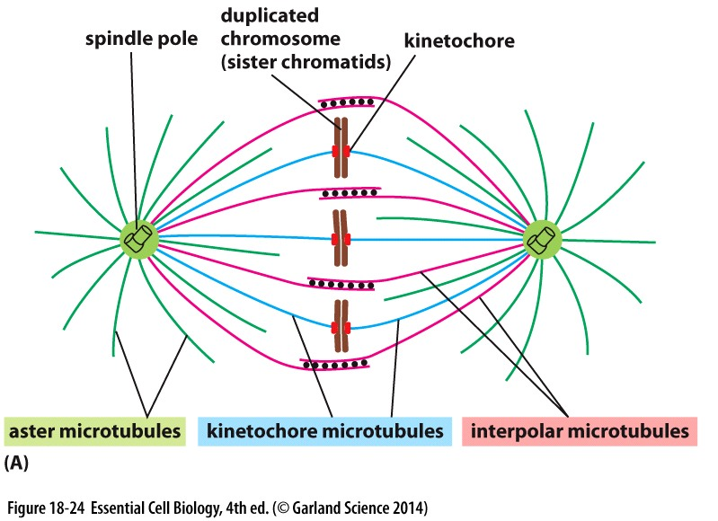
S/G2 phase
Chromosomes are replicated (Checkpoint)
Centrosomes are duplicated
Chromosomes begin to condense
Not all spindle microtubules
are equal
Astral→ very dynamic, search the cytoplasm for chromosomes
Interpolar → dynamic, stabilized by crosslinking and motor proteins that push spindle poles apart
Kinetochore → attachments with kinetochores stabilizes dynamics
Prophase
Nuclear Envelope breaks down
Centrosomes nucleate microtubules/spindle poles
Kinetochores form
Prometa-
phase
Bipolar Spindle begins to form
Microtubules attach to kinetochores
Chromosomes move and begin to align at cell center

Slide 12
S/G2 phase
Chromosomes are replicated (Checkpoint)
Centrosomes are duplicated
Chromosomes begin to condense
Prophase
Nuclear Envelope breaks down
Centrosomes nucleate microtubules/spindle poles
Kinetochores form
Prometa-
phase
Bipolar Spindle begins to form
Microtubules attach to kinetochores
Chromosomes move and begin to align at cell center
Metaphase
All chromosomes align (metaphase plate)
Spindle assembly checkpoint is satisfied

Slide 13
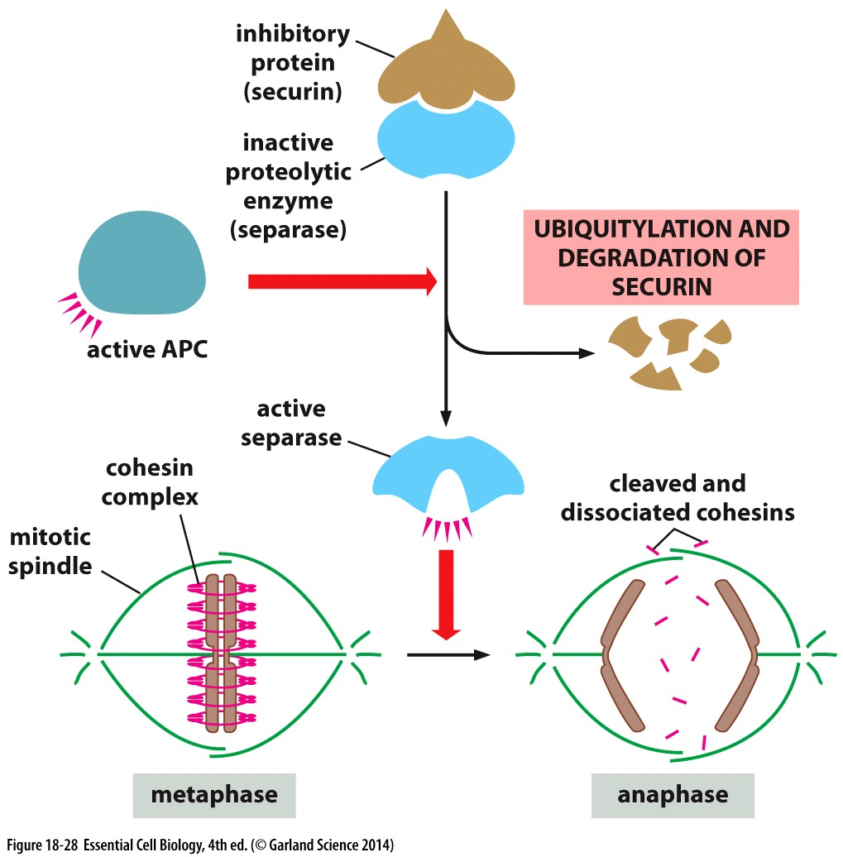
Consequences of checkpoint satisfaction
Anaphase Promoting Complex (APC) targets proteins for degradation
Destruction of securin releases separase
→ releases cohesion & initiates anaphase
APC also targets mitotic Cyclin B for destruction
→ inactivates CDK activity and permits mitotic exit

Slide 14
S/G2 phase
Chromosomes are replicated (Checkpoint)
Centrosomes are duplicated
Chromosomes begin to condense
Prophase
Nuclear Envelope breaks down
Centrosomes nucleate microtubules/spindle poles
Kinetochores form
Prometa-
phase
Bipolar Spindle begins to form
Microtubules attach to kinetochores
Chromosomes move and begin to align at cell center
Metaphase
All chromosomes align (metaphase plate)
Spindle assembly checkpoint is satisfied
Anaphase
Chromosomes are segregated equally into two daughter cells

Slide 15
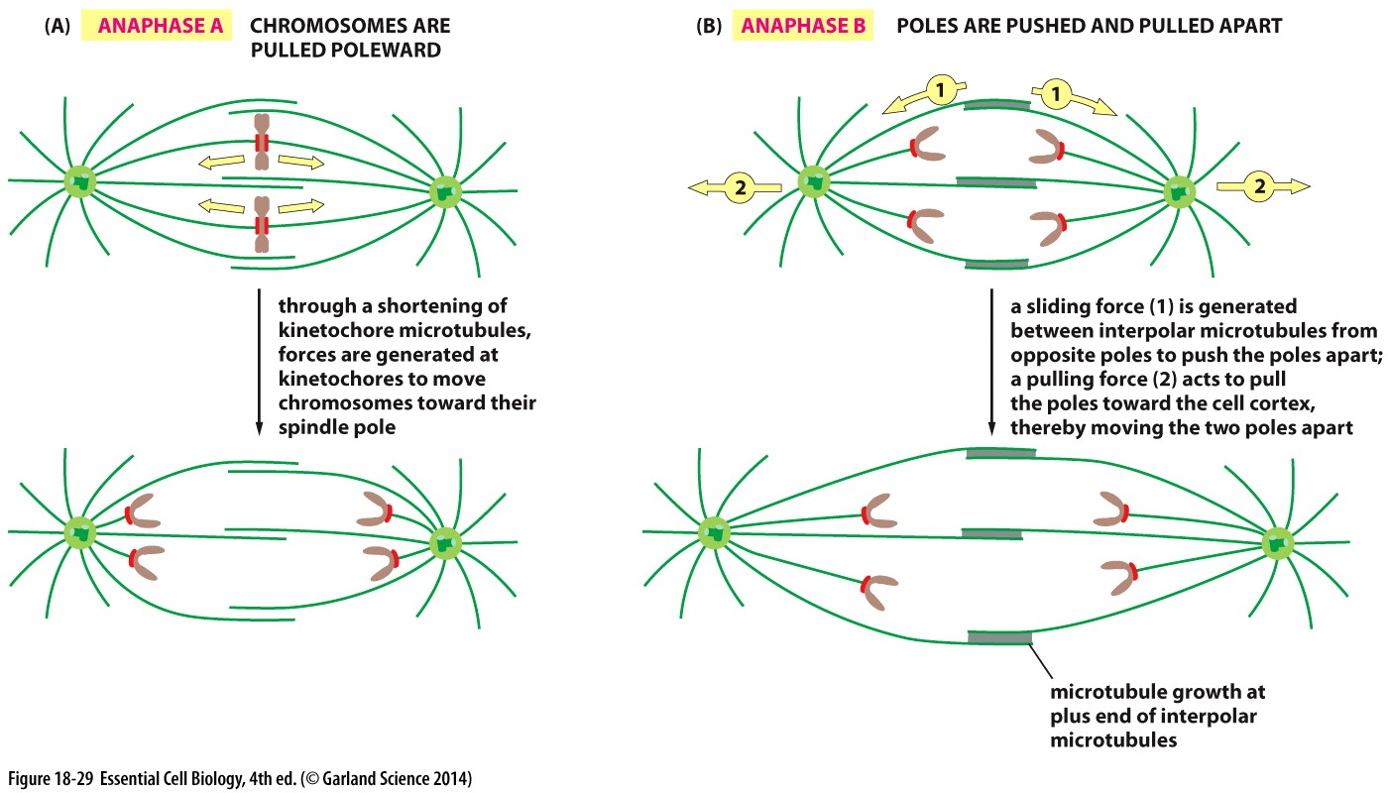
Anaphase onset
Force from depolymerization Force from motors on interpolar microtubules

Slide 16
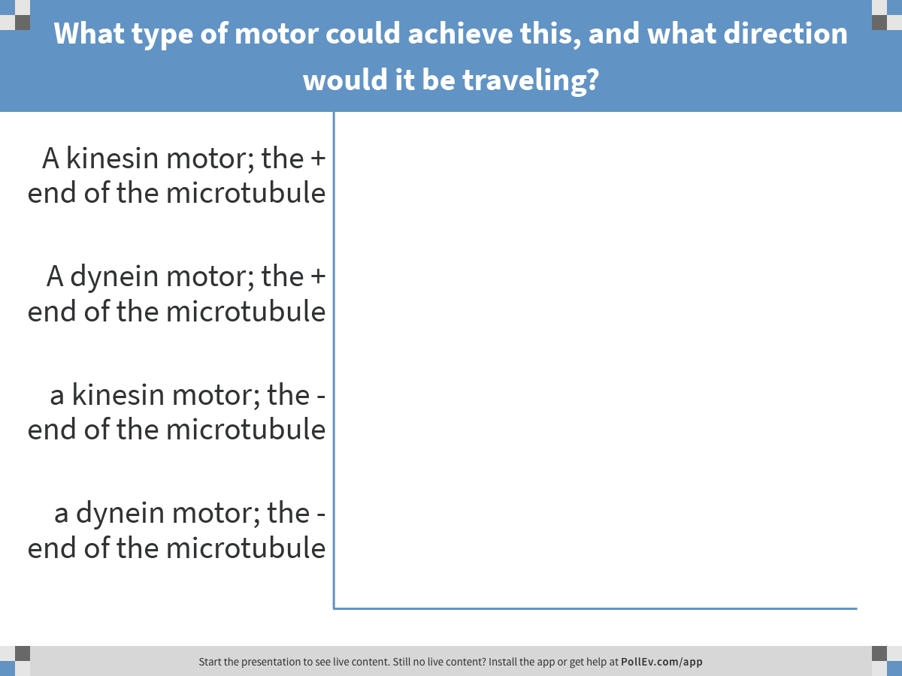
During Anaphase B spindle poles are pushed apart as a result of motor proteins walking on interpolar microtubules.
Notes:
What type of motor could achieve this, and what direction would it be traveling?
https://www.polleverywhere.com/multiple_choice_polls/lUStchypLHFgtFm

Slide 17
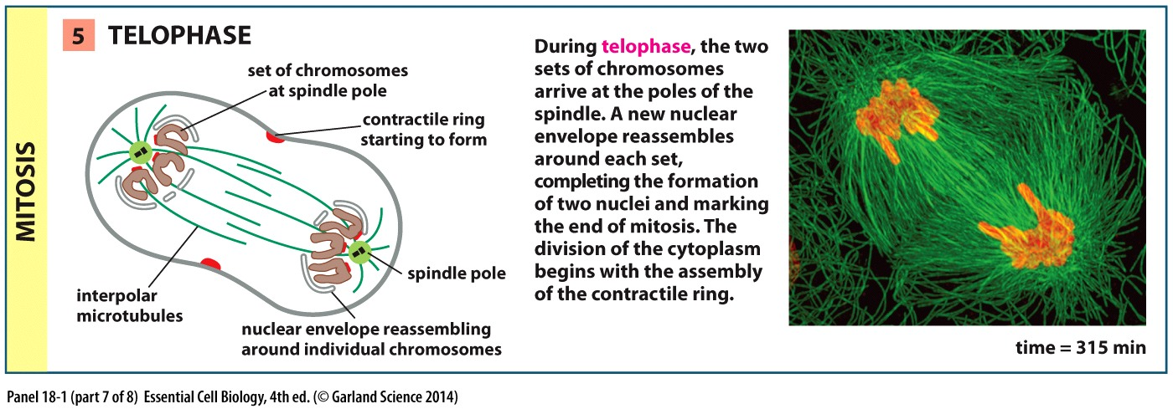
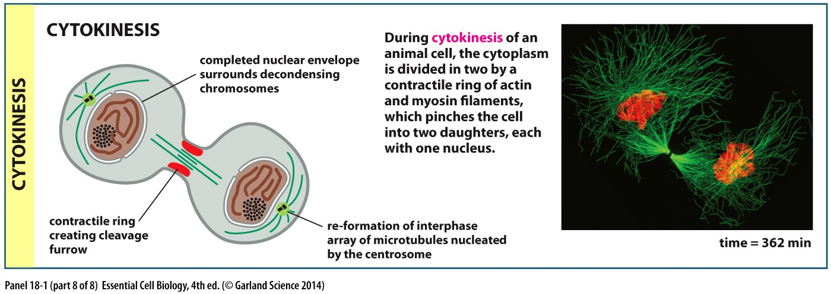
After Nuclear Division: Cytoplasmic Division

Slide 18
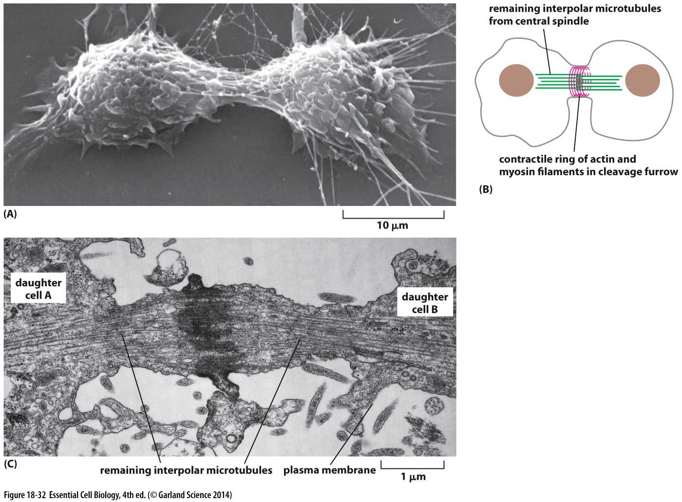
One last spindle function…
Positions the cleavage furrow
Places actin/myosin recruitment factors
Cleavage ALWAYS happens perpendicular to the spindle plane

Slide 19
One last spindle function…
Requires the recruitment of membrane vesicles to seal the furrow
→ traffic along central spindle microtubules

Slide 20
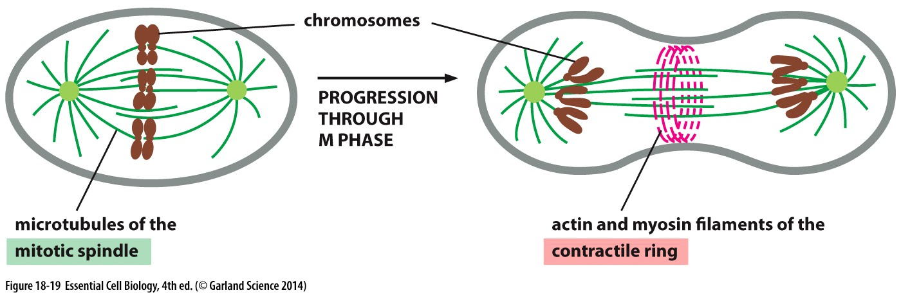
Cytoskeletal components essential for mitosis
Microtubule filaments attach to chromosomes and pull them apart → nuclear division/mitosis
Actin filaments contract the cell membrane to divide the cytoplasm → cytokinesis

Slide 21
understanding basic cell biology
Disease implications

Slide 22
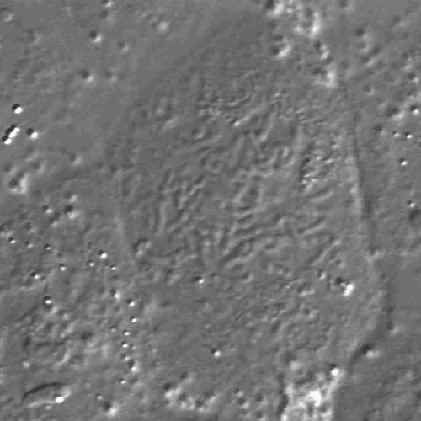
Checkpoints govern mitotic progression
Human Epithelial Cell in Mitosis
Cells enter mitosis and chromosomes begin to align
ALL chromosomes must align for mitosis to proceed
What happens in cancer cells?
Notes:
Again, we can utilize microscopy to visualize this process. This time we’re looking at a human epithelial cell using contrast microscopy. This cell is already in mitosis. You can see the boundry of the cell here…. And these sausage like structures are chromosomes, as I start the movie you’ll begin to see the wiggle about as they make mts attachemnets and begin to align along the center of the cell…..
So that’s what is supposed to happen. But what happens in cancer cells? I told you that cancer is a disease of cellular division gone bad and that many cancer cells exhibit aneuploidy. But is there evidence of mitotic defects that could explain the generation of such aneuploidy in cancer?

Slide 23
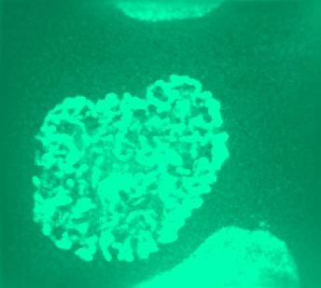
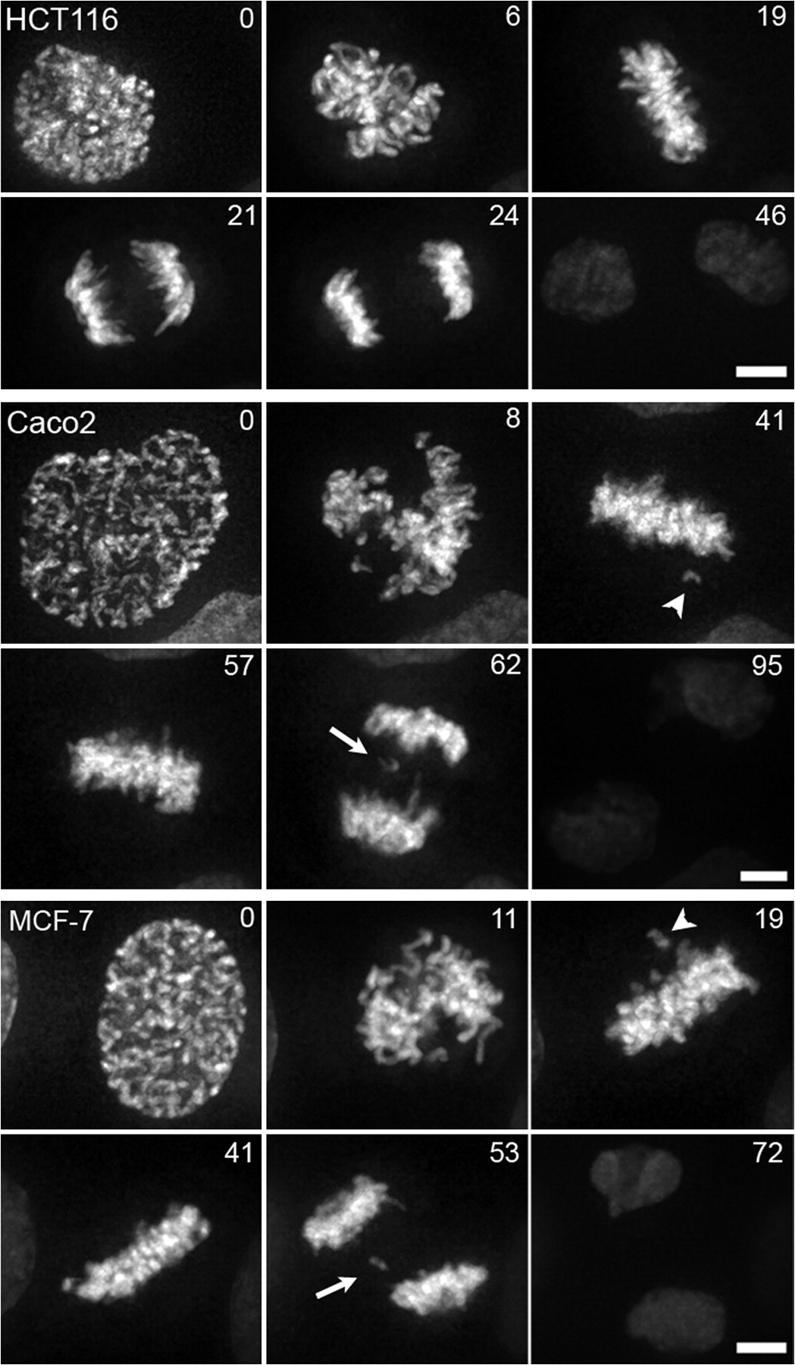
Generating Aneuploidy in Cancer
Checkpoint is intact
Chromosome segregation is compromised

Slide 24
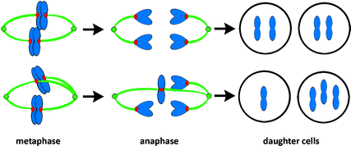
Origin of Segregation Errors
Merotely is the major underlying cause of
segregation errors in Cancer
Normal
amphitelic
Abnormal
merotelic
Merotelic attachment: single kinetochore attached to both spindle poles
Lagging chromosome is a result of ‘Tug of war’ between two poles

Slide 25
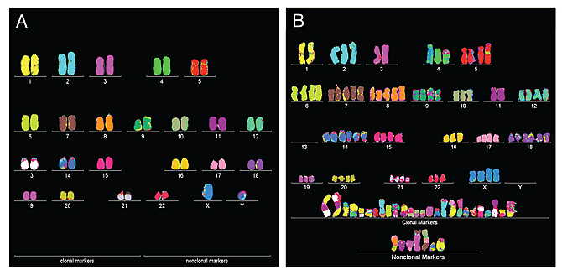
Genome Instability and Mutations
Consistent changes in the DNA content of the cell
Mutations in genes and gene regulatory regions
Aneuploidy: changes in the copy number of genes, pieces of chromosomes or whole chromosomes
Normal Human Cell
Bladder Cancer Cell

Slide 26
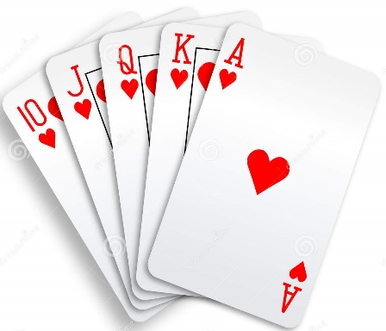
Advantages & Causes of Aneuploidy
Advantage:
Each chromosome gain or loss effects thousands of genes at once: faster than mutating individual genes
Chance to ‘shuffle the deck’ and rapidly sample MANY
different genomic combinations to find the most advantageous one
Cause:
Aneuploidy: changes in chromosome number arise from defects in mitotic segregation
Genome instability: persistent underlying defects in mitosis

Slide 27
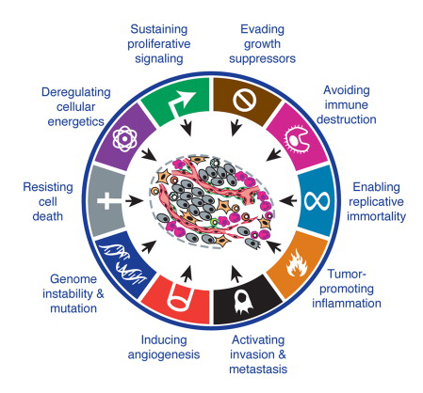


The Hallmarks of Cancer
Sustained proliferative signal
Evading growth suppressors
Deregulating cellular energetics
Avoiding immune destruction
Oncogenes:
promote proliferation- overexpressed/mutated to be always active in cancer
Tumor Suppressors:
Stop cell proliferation-function is lost in cancer
Resisting cell death
Enabling replicative immortality
Tumor-promoting inflammation
Genome instability & mutation
Inducing angiogenesis
Activating invasion & metastasis
Unregulated cell growth
Avoiding cell death

Slide 28

Killing Cancer Cells
Chemotherapy targets all rapidly dividing cells
Collateral damage: other rapidly dividing cells/tissue: blood, digestive tract, hair follicles, reproductive system
Opportunity & need for improvement
Challenge for future scientists:
Achilles heel of cancer?
Identify defining feature of cancer cells
aneuploidy
Uncover molecular targets/processes
Regulators of merotelic attachment
Design Drugs
targeting aneuploidy will likely be an effective therapeutic

